Slide 1
Lecture 4 Label Aggregation: EM-Based Methods
Instructor: Chien-Ju (CJ) Ho

Slide 2
Logistics: Reminders
Review:
The next required reading is mathematically dense. Try to at least understand the formulation and the interpretations of the main results.
Assignments:
Assignment 1 is due next Friday
Assignment 2 will be announced next Tuesday
Bidding of presentations
Form a team and choose 3~5 topics that interest you
Bidding link will be up next Tuesday (and due the same day)
Presentation assignments will be announced next Wednesday
Finding teammates
Stay after lectures and/or utilize Piazza features

Slide 3
Logistics: Project Timeline
Sep 24: Project proposal
Brief description of the proposed project (1~2 paragraph)
Citing at least one paper that’s relevant to your proposal
Oct 15: Milestone 1
A brief literature review and the description of your plan (one page)
Last chance to change the topic of the project
Nov 5: Milestone 2
Summary of your current progress (up to 2 pages)
Last chance to convert the research project to (a more extensive) literature review
Dec 7/9: In-class project presentations
Dec 12: Project report due
About how to choose topics:
I will post a list of example/past projects next week.
Looking at future lectures could help.
Schedule meetings to discuss with me about your project if you like.

Slide 4
A Short Recap of Last Lecture

Slide 5
Course Overview
Human as data sources:
Label aggregation
Probabilistic reasoning to aggregate noisy human data
Practical challenges:
Real-time and complex tasks
Studies on workflow and team designs from HCI perspective
Humans are “Humans”:
Incentive design
Game theoretical modeling of humans and incentive design
Selected recent topics:
Ethical issues of AI/ML, learning with strategic behavior, Human-AI collaborations.

Slide 6
Label Aggregation
 | Worker 1 | Worker 2 | Worker 3 | Worker 4 | …
Task 1 | +1 | -1 |  | -1
Task 2 |  | -1 | +1
Task 3 | -1 |  |  | +1
Task 4 |  | +1 | +1
…
Goal: infer true labels
Challenges
Unknown worker skills
Different task difficulties
More factors to consider (some structures of tasks/workers?)

Slide 7
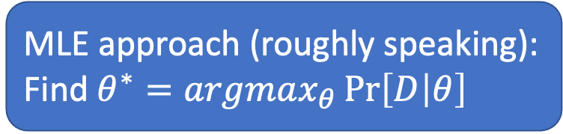
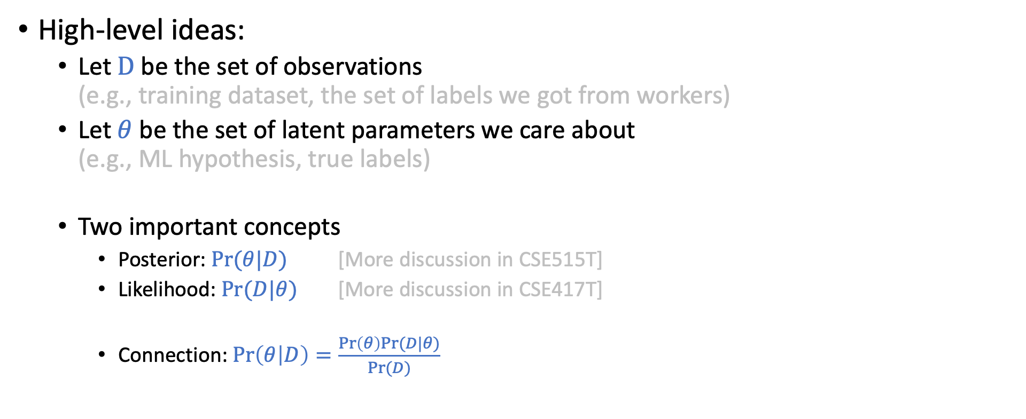
Probabilistic Approach for Label Aggregation
High-level ideas:
Let $D$be the set of observations (e.g., training dataset, the set of labels we got from workers)
Let $θ$ be the set of latent parameters we care about (e.g., ML hypothesis, true labels)
Two important concepts
Posterior: $\operatorname{Pr}{(θ|D)}$ [More discussion in CSE515T]
Likelihood: $Pr⁡(D|θ)$ [More discussion in CSE417T]
Connection: $\operatorname{Pr}\left(θ | D\right)=\frac{\operatorname{Pr}\left(θ\right)Pr⁡(D|θ)}{Pr⁡(D)}$
MLE approach (roughly speaking):
Find $θ^{∗}=argmax_{θ}\operatorname{Pr}\left[D | θ\right]$

Slide 8
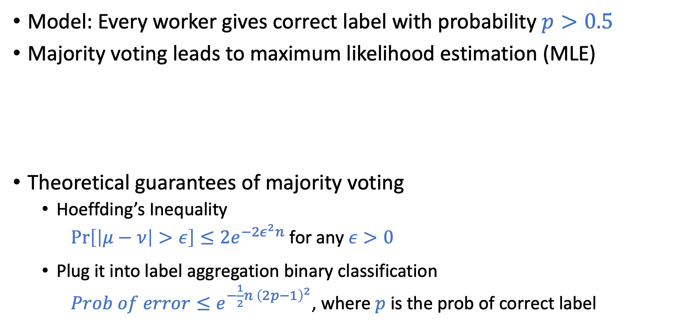
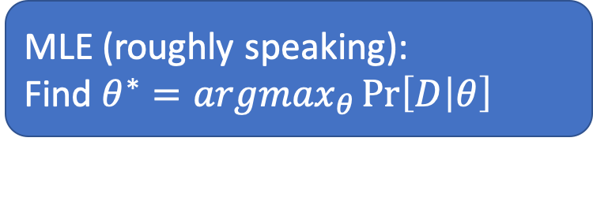
Majority Voting for ”Homogeneous” Workers
Model: Every worker gives correct label with probability $p>0.5$
Majority voting leads to maximum likelihood estimation (MLE)
Theoretical guarantees of majority voting
Hoeffding’s Inequality
$\operatorname{Pr}\left[\left|μ−ν\right|>ε\right]≤2e^{−2ε^{2}n}$ for any $ε>0$
Plug it into label aggregation binary classification
$Prob of error≤e^{−\frac{1}{2}n {\left(2p−1\right)}^{2}}$, where $p$ is the prob of correct label
MLE (roughly speaking):
Find $θ^{∗}=argmax_{θ}\operatorname{Pr}\left[D | θ\right]$
Draw with replacement
n: number of samples

Slide 9
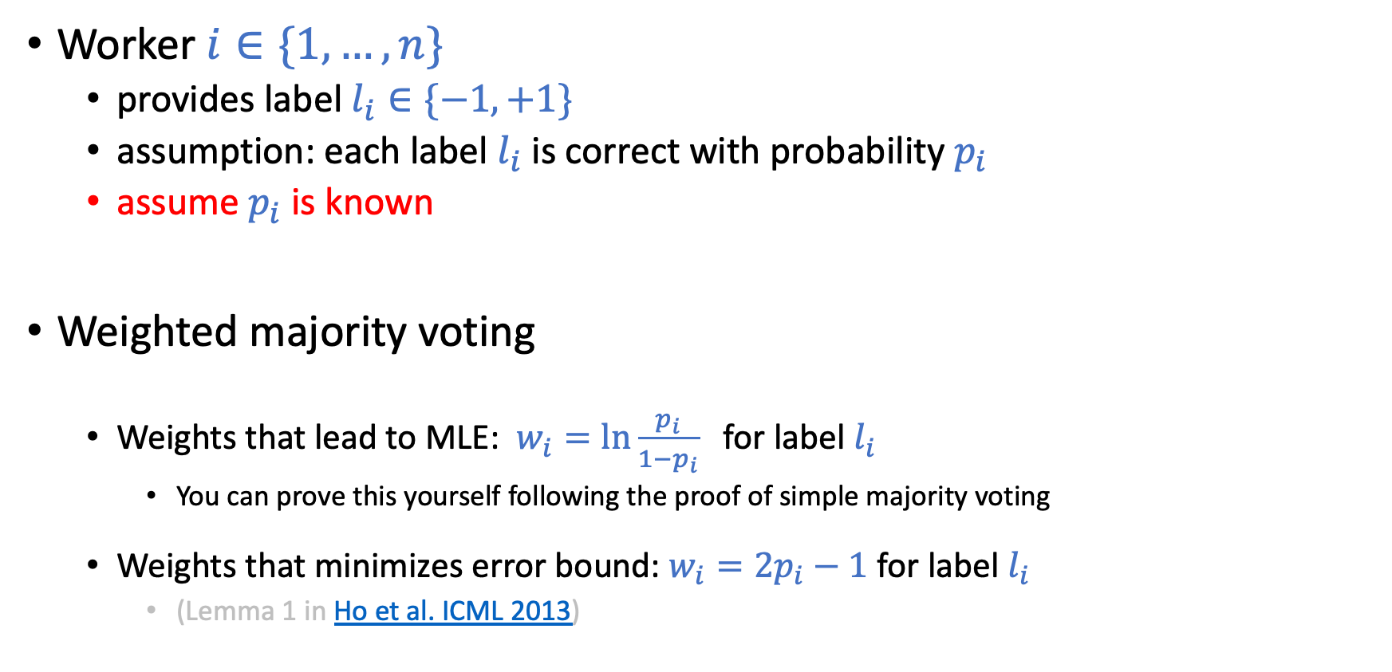
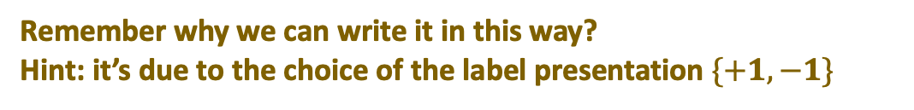
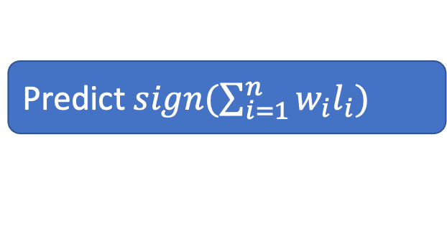
What if Workers are Heterogeneous
Worker $i∈\{1,…,n\}$
provides label $l_{i}∈\{−1,+1\}$
assumption: each label $l_{i}$ is correct with probability $p_{i}$
assume $p_{i}$ is known
Weighted majority voting
Weights that lead to MLE: $w_{i}=ln{\frac{p_{i}}{1−p_{i}}}$ for label $l_{i}$
You can prove this yourself following the proof of simple majority voting
Weights that minimizes error bound: $w_{i}=2p_{i}−1$ for label $l_{i}$
(Lemma 1 in Ho et al. ICML 2013)
Remember why we can write it in this way?
Hint: it’s due to the choice of the label presentation $\{+1,−1\}$
Predict $sign(\sum_{i=1}^{n}{w_{i}l_{i}})$

Slide 10
Today’s Lecture

Slide 11
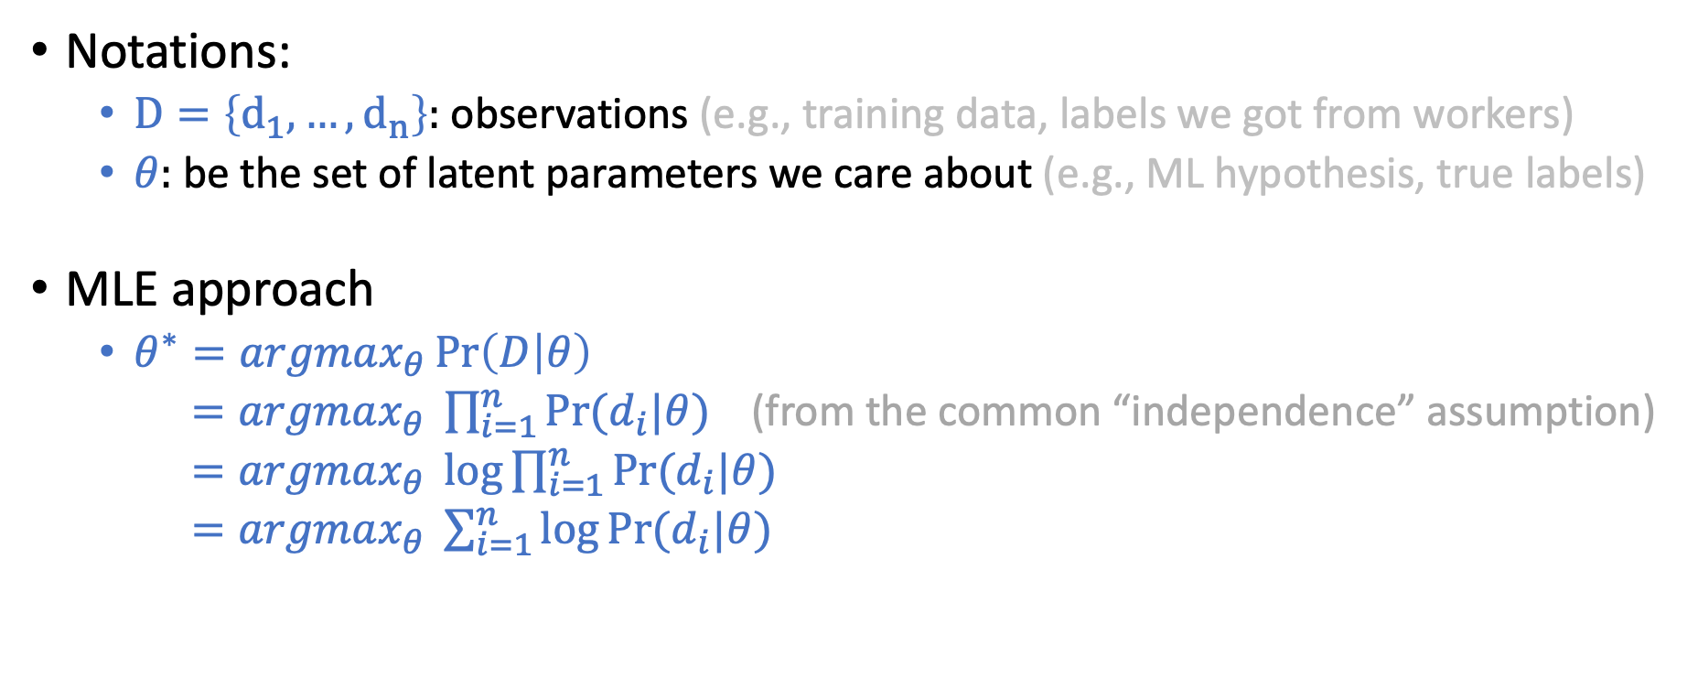
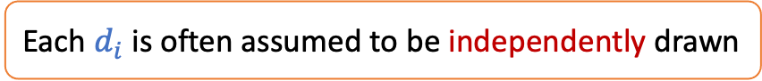
Framework for Probabilistic Inference
Each $d_{i}$ is often assumed to be independently drawn
Notations:
$D=\left\{d_{1},…,d_{n}\right\}:$observations (e.g., training data, labels we got from workers)
$θ:$be the set of latent parameters we care about (e.g., ML hypothesis, true labels)
MLE approach
$θ^{∗}=argmax_{θ}\operatorname{Pr}\left(D | θ\right)$
$=argmax_{θ} \prod_{i=1}^{n}{Pr⁡(d_{i}|θ)}$ (from the common “independence” assumption)
$=argmax_{θ} \log{\prod_{i=1}^{n}{Pr⁡(d_{i}|θ)}}$
$=argmax_{θ} \sum_{i=1}^{n}{\log{Pr⁡(d_{i}|θ)}}$
In machine learning, we often replace this as a (negative) point-wise “loss function”
Notes:
In logistic regression, minimizes cross-entry loss is the same as maximizing likelihood

Slide 12
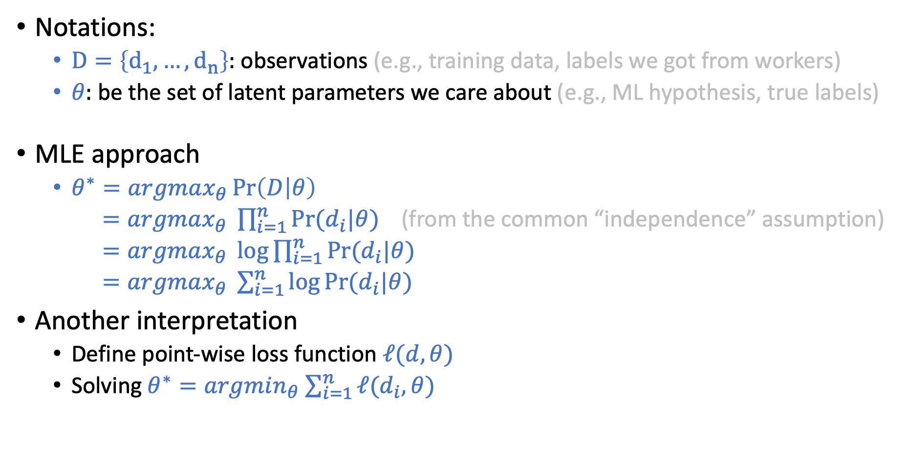
Framework for Probabilistic Inference
Each $d_{i}$ is often assumed to be independently drawn
Notations:
$D=\left\{d_{1},…,d_{n}\right\}:$observations (e.g., training data, labels we got from workers)
$θ:$be the set of latent parameters we care about (e.g., ML hypothesis, true labels)
MLE approach
$θ^{∗}=argmax_{θ}\operatorname{Pr}\left(D | θ\right)$
$=argmax_{θ} \prod_{i=1}^{n}{Pr⁡(d_{i}|θ)}$ (from the common “independence” assumption)
$=argmax_{θ} \log{\prod_{i=1}^{n}{Pr⁡(d_{i}|θ)}}$
$=argmax_{θ} \sum_{i=1}^{n}{\log{Pr⁡(d_{i}|θ)}}$
Another interpretation
Define point-wise loss function $ℓ(d,θ)$
Solving $θ^{∗}=argmin_{θ}$ $\sum_{i=1}^{n}{ℓ(d_{i},θ)}$
Solving this optimization problem is one of the “key” steps in machine learning.
Notes:
In logistic regression, minimizes cross-entry loss is the same as maximizing likelihood

Slide 13
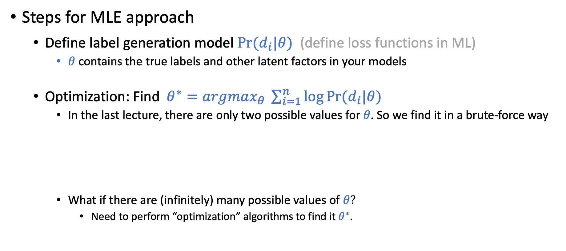
Get Back to Label Aggregation
Steps for MLE approach
Define label generation model $Pr⁡(d_{i}|θ)$ (define loss functions in ML)
$θ$ contains the true labels and other latent factors in your models
Optimization: Find $θ^{∗}=argmax_{θ} \sum_{i=1}^{n}{\log{Pr⁡(d_{i}|θ)}}$
In the last lecture, there are only two possible values for $θ$. So we find it in a brute-force way
What if there are (infinitely) many possible values of $θ?$
Need to perform “optimization” algorithms to find it $θ^{∗}$.

Slide 14
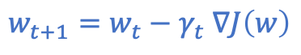
Optimization
One of the key elements in modern machine learning
The reason most ML courses require probability, calculus, and linear algebra
Assume the function we want to minimize (maximize) is convex (concave)
Gradient descent is one of the most commonly-used algorithm
What if the function is not convex
Start at a random point, do many times, report the best one
(This is essentially what deep learning is doing for minimizing loss)
$w_{t+1}=w_{t}−γ_{t} ∇J\left(w\right)$
1. Requires gradient to exist everywhere 2. Only guarantees to find local optimum
In convex functions, local optimum == global optimum

Slide 15
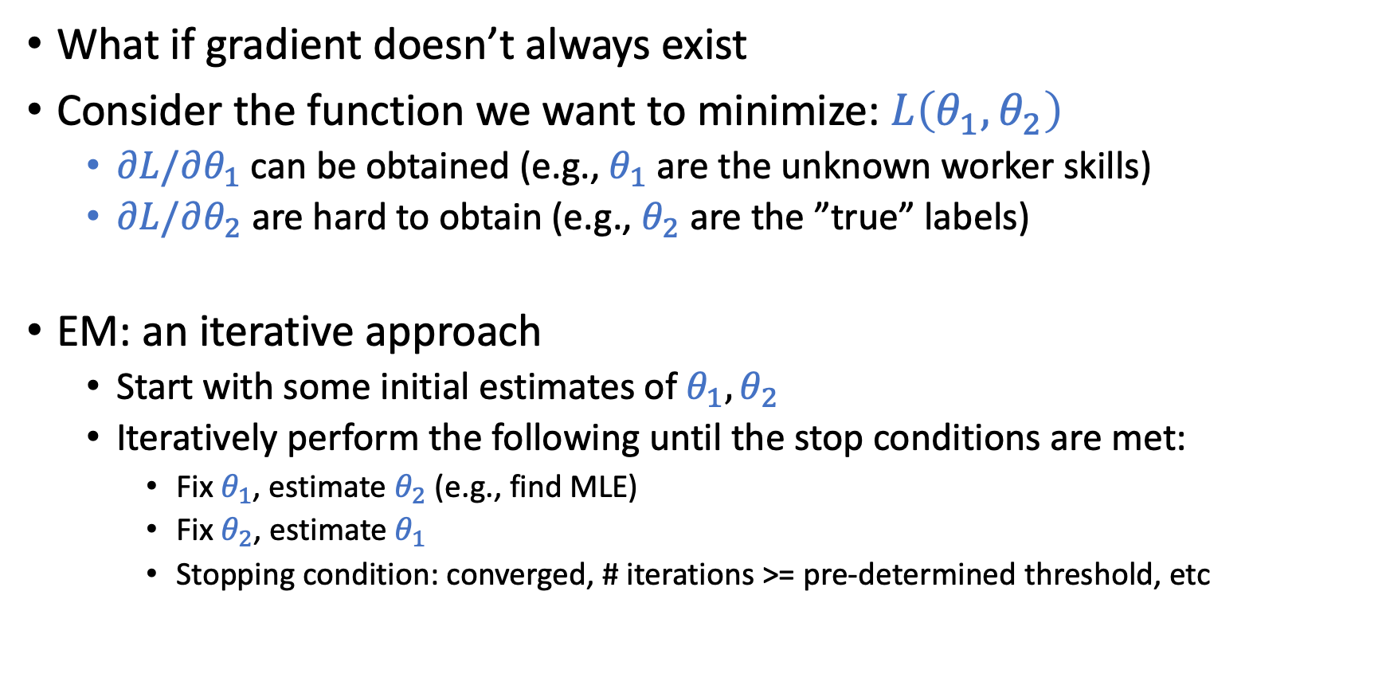
Expectation-Maximization (EM)
What if gradient doesn’t always exist
Consider the function we want to minimize: $L\left(θ_{1},θ_{2}\right)$
$∂L/∂θ_{1}$ can be obtained (e.g., $θ_{1}$ are the unknown worker skills)
$∂L/∂θ_{2}$ are hard to obtain (e.g., $θ_{2}$ are the ”true” labels)
EM: an iterative approach
Start with some initial estimates of $θ_{1}, θ_{2}$
Iteratively perform the following until the stop conditions are met:
Fix $θ_{1}$, estimate $θ_{2}$ (e.g., find MLE)
Fix $θ_{2}$, estimate $θ_{1}$
Stopping condition: converged, # iterations >= pre-determined threshold, etc
Only guarantee to converge to local optimum.

Slide 16
Consider a simpler case: Optional Reading
Maximum Likeihood Estimation of Observer Error-Rates Using the EM Algorithm. Dawid and Skene. Applied Statistics. 1979.

Slide 17
Motivating Scenario
Multiple doctors give diagnosis based on a patient’s information
Doctors might make mistakes (with unknown probability)
Given diagnosis from multiple doctors, how to infer the patients’ true condition
In the context of label aggregation
Doctors -> workers
Diagnosis -> labels
They consider the setting all tasks are the same

Slide 18
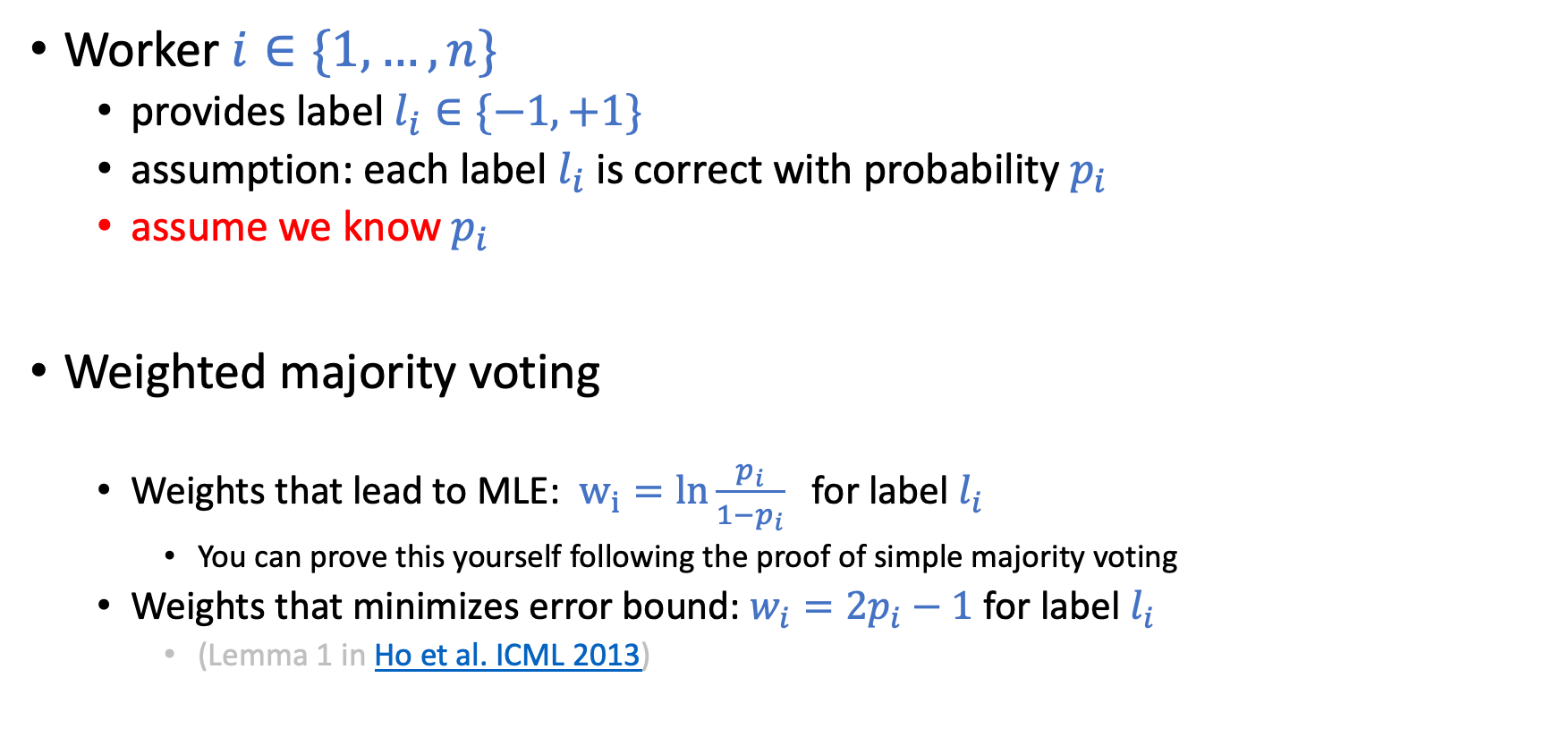
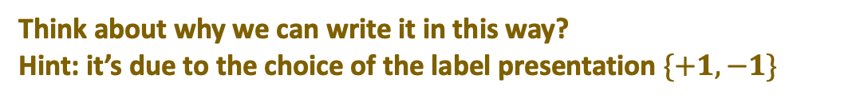

Reminder: If Worker Skills are Known
Worker $i∈\{1,…,n\}$
provides label $l_{i}∈\{−1,+1\}$
assumption: each label $l_{i}$ is correct with probability $p_{i}$
assume we know $p_{i}$
Weighted majority voting
Weights that lead to MLE: $w_{i}=ln{\frac{p_{i}}{1−p_{i}}}$ for label $l_{i}$
You can prove this yourself following the proof of simple majority voting
Weights that minimizes error bound: $w_{i}=2p_{i}−1$ for label $l_{i}$
(Lemma 1 in Ho et al. ICML 2013)
Think about why we can write it in this way?
Hint: it’s due to the choice of the label presentation $\{+1,−1\}$
Predict $sign(\sum_{i=1}^{n}{w_{i}l_{i}})$

Slide 19
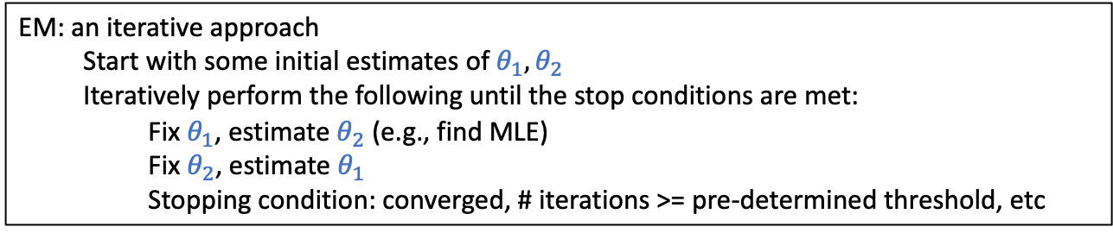
What if Workers’ Skills are Unknown
Short Discussion: What can we do?
Think about the EM idea we just discussed
 | Worker 1 | Worker 2 | Worker 3 | Worker 4 | Worker 5
Task 1 | -1 | +1 | -1 | +1 | -1
Task 2 | +1 | +1 | -1 | +1 | -1
Task 3 | +1 | -1 | +1 | -1 | +1
Task 4 | -1 | -1 | +1 | +1 | +1
EM: an iterative approach
Start with some initial estimates of $θ_{1}, θ_{2}$
Iteratively perform the following until the stop conditions are met:
Fix $θ_{1}$, estimate $θ_{2}$ (e.g., find MLE)
Fix $θ_{2}$, estimate $θ_{1}$
Stopping condition: converged, # iterations >= pre-determined threshold, etc

Slide 20
What if Workers’ Skills are Unknown
 | Worker 1 | Worker 2 | Worker 3 | Worker 4 | Worker 5
Task 1 | -1 | +1 | -1 | +1 | -1
Task 2 | +1 | +1 | -1 | +1 | -1
Task 3 | +1 | -1 | +1 | -1 | +1
Task 4 | -1 | -1 | +1 | +1 | +1

Slide 21
High-Level Description of EM
Making Better Use of the Crowd: How Crowdsourcing Can Advance Machine Learning Research. Vaughan. JMLR 2018.

Slide 22
Required Reading
Whose Vote Should Count More: Optimal Integration of Labels from Labelers of Unknown Expertise. Whitehill et al. NIPS 2009.

Slide 23
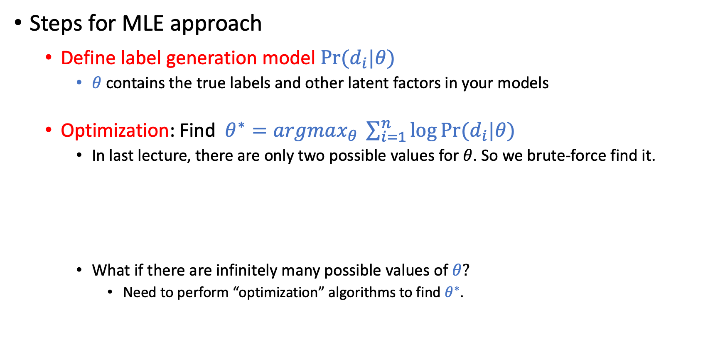
Reminder on the Framework
Steps for MLE approach
Define label generation model $Pr⁡(d_{i}|θ)$
$θ$ contains the true labels and other latent factors in your models
Optimization: Find $θ^{∗}=argmax_{θ} \sum_{i=1}^{n}{\log{Pr⁡(d_{i}|θ)}}$
In last lecture, there are only two possible values for $θ$. So we brute-force find it.
What if there are infinitely many possible values of $θ?$
Need to perform “optimization” algorithms to find $θ^{∗}$.

Slide 24
Model of Label Generation
What do these parameters mean?

Slide 25
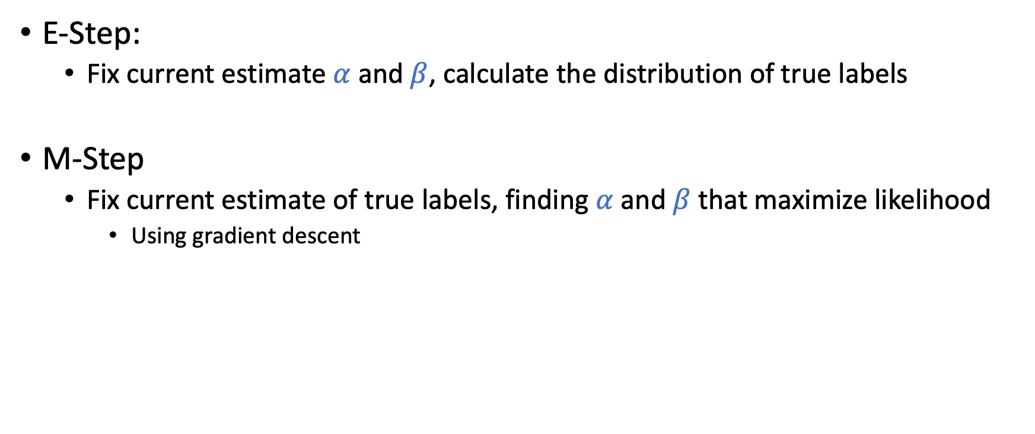
Using EM to find the MLE
E-Step:
Fix current estimate $α$ and $β$, calculate the distribution of true labels
M-Step
Fix current estimate of true labels, finding $α$ and $β$ that maximize likelihood
Using gradient descent

Slide 26
Simulation/Experiments

Slide 27
Discussion
What are your general thoughts about the paper.
When do you think majority voting would be a preferred method than GLAD or other more sophisticated method?
What other aspects of label generation do you think can/should also be modeled (the application doesn't need to be restricted to image labeling)?

Slide 28
When Majority-Voting Might Be Preferred
Not enough data: Occam’s Razor
Fairness considerations: When the outcome impacts people
Can we give different weights to voters in Presidential Elections?
When the label is subjective
Aggregating preferences is a hard question
Arrow’s impossibility theorem

Slide 29
What Other Aspects to Model
Confusion matrix
Instead of using a single probability for modeling worker skills for tasks
Ground Truth
 | Label 1 | Label 2 | Label 3
Label 1 | 0.8 | 0.1 | 0.1
Label 2 | 0.1 | 0.9 | 0
Label 3 | 0.1 | 0.2 | 0.7
Worker Label

Slide 30
What Other Aspects to Model
The Multidimensional Wisdom of Crowds. Welinder et al. NIPS 2010

Slide 31
What Other Aspects to Model
Temporal Information
Workers get more experienced over time
[some recent relevant research topic: machine teaching]
Workers get tired over time
Most approaches are pretty ad-hoc

Slide 32
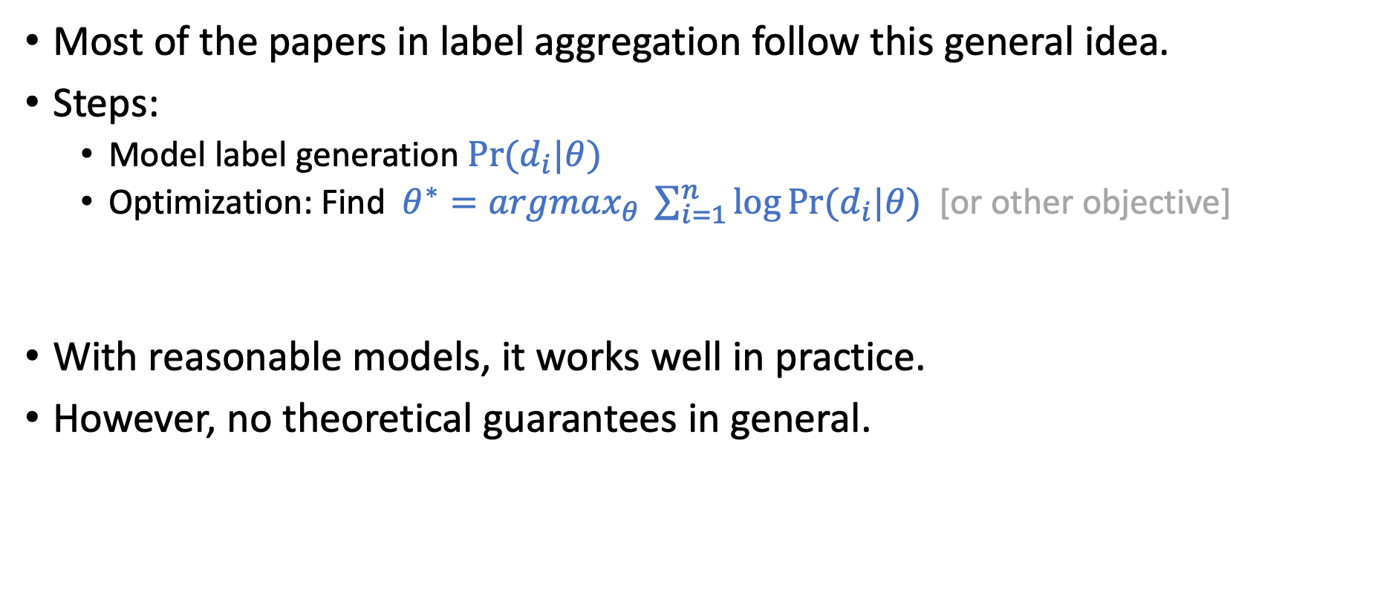
General Framework for Label Aggregation
Most of the papers in label aggregation follow this general idea.
Steps:
Model label generation $Pr⁡(d_{i}|θ)$
Optimization: Find $θ^{∗}=argmax_{θ} \sum_{i=1}^{n}{\log{Pr⁡(d_{i}|θ)}}$ [or other objective]
With reasonable models, it works well in practice.
However, no theoretical guarantees in general.

Slide 33
Next Lecture
Read papers that give theoretical guarantees
Be prepared for the more math-heavy reading
Try to at least understand the formulation/models and the interpretations of the main results
Notes:
Give some personal remarks on label aggregation

